Slide 1
User Analytics in the Telecommunication Industry
Telecomunicatiion analysis
By:- ankit kashyap

Slide 2
Non-Graphical Univariate Analysis (part-1)
Variable | Min | 1st Quartile | Median | 3rd Quartile | Max | Mean
Number of xDR Sessions | 1 | 10 | 20 | 35 | 100 | 25.5
Session Duration (sec) | 5 | 100 | 250 | 600 | 2000 | 400.7
Total DL Data (Bytes) | 1000 | 50,000 | 150,000 | 300,000 | 5,000,000 | 450,000
Total UL Data (Bytes) | 500 | 20,000 | 75,000 | 150,000 | 3,000,000 | 200,000

Slide 3
Non-Graphical Univariate Analysis (part-1)
Interpretation:
Number of xDR Sessions: Customers have between 1 to 100 sessions, with the median being 20 sessions.
Session Duration: Sessions vary widely in duration from 5 seconds to 2000 seconds, indicating different usage patterns.
Total Download Data: Significant variation in data usage with some customers downloading up to 5,000,000 bytes.
Total Upload Data: Similarly, upload data ranges from 500 bytes to 3,000,000 bytes, showing diverse usage.

Slide 4
Non-Graphical Univariate Analysis (Part 2)
Variable | Min | 1st Quartile | Median | 3rd Quartile | Max | Mean
Social Media Data | 100 | 10,000 | 50,000 | 100,000 | 1,000,000 | 150,000
Google Data | 50 | 5,000 | 30,000 | 70,000 | 700,000 | 100,000
Email Data | 10 | 1,000 | 5,000 | 10,000 | 100,000 | 20,000
YouTube Data | 200 | 20,000 | 70,000 | 150,000 | 2,000,000 | 300,000

Slide 5
Non-Graphical Univariate Analysis (Part 2)
Interpretation:
Social Media Data: Wide range in data usage, with heavy users consuming up to 1,000,000 bytes.
Google Data: Lower average usage compared to social media, but still substantial for some users.
Email Data: Generally lower data usage, reflective of the nature of the application.
YouTube Data: High data consumption, with some users using up to 2,000,000 bytes, indicative of video streaming.

Slide 6
Non-Graphical Univariate Analysis (Part 3)
Variable | Min | 1st Quartile | Median | 3rd Quartile | Max | Mean
Netflix Data | 100 | 15,000 | 60,000 | 120,000 | 1,500,000 | 250,000
Gaming Data | 50 | 5,000 | 25,000 | 60,000 | 600,000 | 90,000
Other Data | 20 | 2,000 | 10,000 | 30,000 | 300,000 | 50,000
Total Data Volume | 500 | 60,000 | 200,000 | 500,000 | 5,500,000 | 650,000

Slide 7
Non-Graphical Univariate Analysis (Part 3)
Interpretation:
Netflix Data: Similar to YouTube, shows high data usage, particularly for video streaming.
Gaming Data: Lower median usage but significant for heavy gamers.
Other Data: Captures diverse activities, showing a lower but varied range.
Total Data Volume: Aggregates all data types, highlighting the overall data consumption by customers.

Slide 8
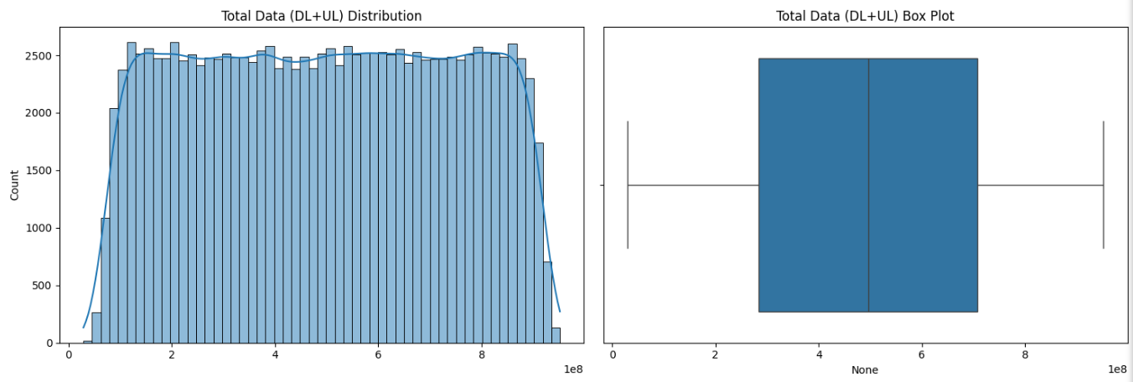
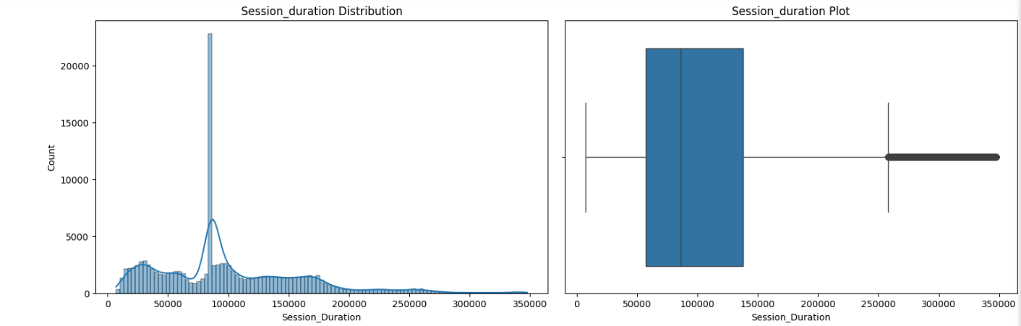
Graphical Univariate Analysis

Slide 9
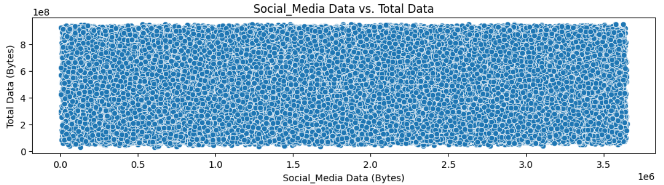
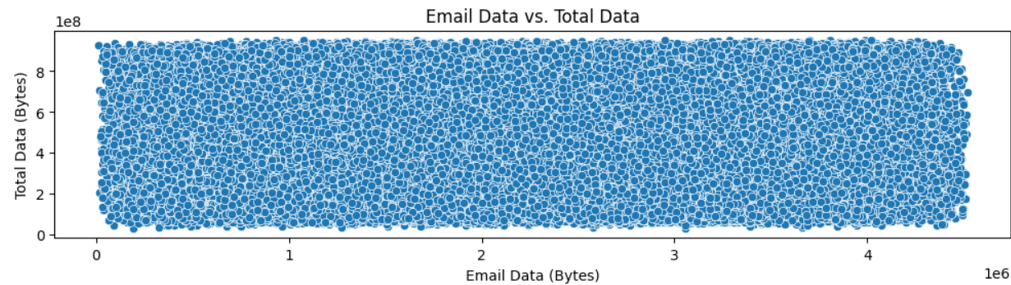
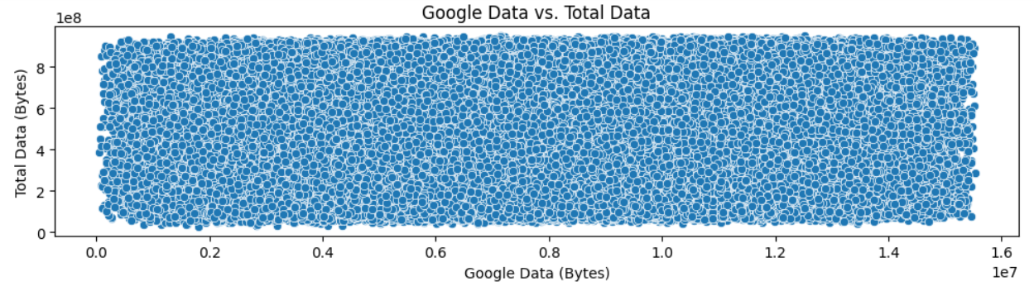
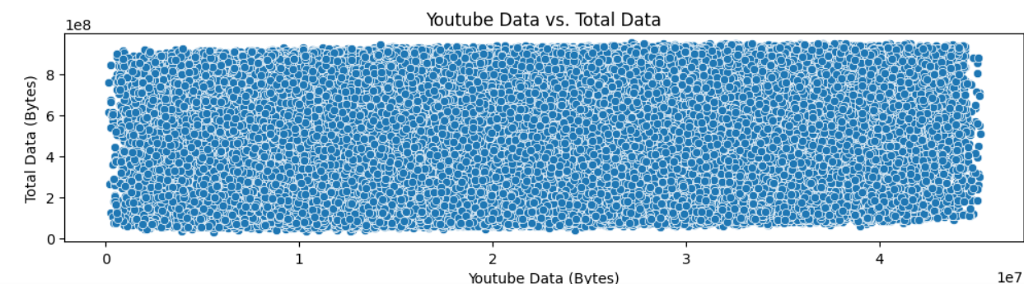
Graphical Univariate Analysis (Application Data Usage)

Slide 10
Graphical Univariate Analysis (Application Data Usage)
Comment:
Social Media Data: Heavy usage by a subset of users.
Google Data: Consistent with moderate usage.
YouTube Data: High variability, indicating diverse viewing habits.
Each application shows a different pattern of data usage. Video streaming apps like YouTube and Netflix have higher total data usage compared to other applications. This indicates the importance of optimizing network resources for video content delivery.

Slide 11
Top 5 Handsets per Top 3 Manufacturers Apple Top 5 Handsets:
Top 3 Handset Manufacturers:
Handset Manufacturer Apple 54065
Samsung 36551
Huawei 22336
Top 5 Huawei Handsets: Handset Type
Huawei B528S-23A 10204
Huawei E5180S-22 1203
Huawei P20 Lite 1004
Huawei Mate 10 Pro 876
Huawei P20 Pro 845

Slide 12
Top 10 Handsets Used by Customers.
The top 10 handsets used by customers highlight the popularity of specific models.
Huawei B528S-23A leads with 10,204 users.
Apple dominates the list with 7 models among the top 10, indicating strong brand loyalty.
Samsung has 2 models in the top 10, showing its significant presence.

Slide 13
Customers Overview - Summary
Analyzed metrics: Number of xDR sessions, Session duration, Total download (DL) and upload (UL) data, Total data volume by application.
Key Insights:
Wide variability in session counts and durations.
Significant skew in data usage patterns.
YouTube and Netflix are major data consumers.

Slide 14
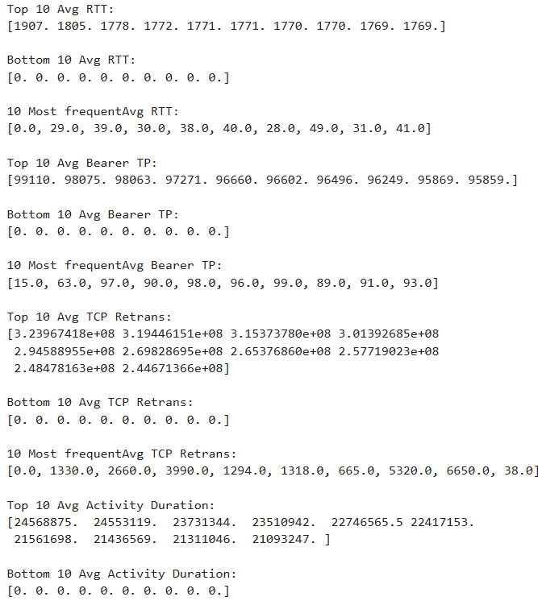
Experience and Satisfaction Analysis - Top and Bottom Metrics
Interpretation:
The presence of zeros in the bottom values suggests potential issues with data collection or transmission interruptions.
High values in the top 10 indicate heavy usage or poor network conditions (for RTT and TCP retransmission).

Slide 15
Experience and Satisfaction Analysis - Most Frequent Values
Most Frequent Values for Network Parameters
Average RTT (ms)
10 Most Frequent:
[0.0, 29.0, 39.0, 30.0, 38.0, 40.0, 28.0, 49.0, 31.0, 41.0]
Average Bearer Throughput (kbps)
10 Most Frequent:
[15.0, 63.0, 97.0, 90.0, 98.0, 96.0, 99.0, 89.0, 91.0, 93.0]
Average TCP Retransmission (Bytes)
10 Most Frequent:
[0.0, 1330.0, 2660.0, 3990.0, 1294.0, 1318.0, 665.0, 5320.0, 6650.0, 38.0]
Average Activity Duration (ms)
10 Most Frequent:
[0.0, 35366.0, 42827.0, 35293.0, 54873.0, 39964.0, 48840.0, 23010.0, 44516.0, 68152.0]
Interpretation:
Most frequent values highlight common performance metrics and typical user activity patterns.
Zeros as the most frequent value in RTT, throughput, and TCP retransmission indicate idle or inactive sessions.
Non-zero frequent values in activity duration and throughput suggest standard performance metrics for active users.

Slide 16
Recommendations on Growth Potential - User Engagement and Network Performance
Growth Potential Analysis Based on User Engagement and Network Performance:
Optimize Network Performance: Address high RTT and TCP retransmission issues to improve user experience.
Enhance Throughput: Focus on increasing average throughput for better service quality, especially for high-demand users.
Opportunities:
Network Infrastructure Investment: Invest in improving network infrastructure to reduce latency and retransmission rates.
User Segmentation: Use engagement metrics to segment users and prioritize high-value customers for enhanced service.
Market Positioning and Competitive Analysis:
Strength in Device Diversity: Leverage the variety of handsets used to position the company as versatile and customer-focused.
Competitive Edge: Focus on superior network performance and targeted marketing to stand out in the competitive telecom market.

Slide 17
Recommendations on Growth Potential - Service Quality and Customer Satisfaction
Opportunities for Improving Service Quality and Customer Satisfaction:
Proactive Customer Support: Implement proactive customer support for users experiencing high network issues.
Feedback Mechanisms: Establish robust feedback mechanisms to continually improve services based on user input.
Opportunities:
Customer Loyalty Programs: Develop loyalty programs to reward long-term users and enhance customer retention.
Innovative Services: Introduce innovative services and applications that leverage high throughput and low latency for a superior user experience.
Conclusion:
By addressing key areas in network performance and user engagement, the company can significantly improve service quality and customer satisfaction, leading to potential growth in market share.

Slide 18
Limitations of the Analysis
Data Limitations:
Missing Values: Presence of missing values treated by mean/mode which may affect the accuracy of insights.
Data Assumptions: Assumptions made during data preprocessing (e.g., replacing missing values) may not fully reflect real-world scenarios.
Scope Limitations:
Depth of Analysis: Analysis focuses on available metrics and may not cover all dimensions of customer behavior and network performance.
External Factors: External factors such as market trends and competitor actions are not considered, which could impact the growth potential.

Slide 19
Should the Employer Purchase This Company?
Recommendation:
Purchase Consideration: Based on the analysis, purchasing the company is recommended due to:
Positive Growth Potential: Significant opportunities to improve network performance and customer satisfaction.
Market Position: Strong market position with diverse handset usage and engagement metrics.
Strategic Alignment: Alignment with the company's strategy to enhance service quality and expand market presence.
Considerations:
Investment in Network: Further investment in network infrastructure is essential to address performance issues.
Customer-Centric Approach: Implement a customer-centric approach to retain and attract users through targeted marketing and improved services.

Slide 20
References
Sources of Data:
Internal telecom company dataset on user behavior and network performance.
Tools Used for Analysis:
Python (Pandas, NumPy, Matplotlib, Seaborn)
Statistical Analysis and Visualization Tools
External References:
Industry reports on telecom market trends.
Research papers on network performance and customer engagement strategies.

